Slide 1
GST : POST - COVID ISSUES
by
Swamy associates®

Slide 2
IMPACTING DECISIONS…
JUDGEMENTS, ADVANCE RULINGS, CIRCULARS, ETC…

Slide 3
BRAND EQUITY TREATIES LIMITED
BETL was unable to file TRAN-1 within the prescribed due date – Dec 2017.
In absence of any time limit under CGST Act, time limit of three years (as prescribed under Limitation Act, 1963) from the appointed day (01.07.2017) has to be construed as the time limit for transitioning CENVAT credit into GST regime, by which, TRAN-1 was allowed to be filed till 30.06.2020.
Sub-Rule (1A) to Rule 117 is held to be ultra vires to Article 14 of the Constitution of India.

Slide 4
SKH SHEET METAL COMPONENTS
Govt amended Sec 140 of CGST Act retrospectively to overcome BETL ratio.
Delhi HC in SKH case maintained BETL ratio despite reto-amendment.
HC also advised the Govt to publicise the decision and also open the portal to enable filing of TRAN-1.
As expected the Govt appealed to the Hon’ble Supreme Court.
Hon’ble SC stayed the BETL judgement on 19.06.2020

Slide 5
OTHER HC / AAR Rulings…
No IGST on inward Ocean Freight – Mohit Minerals – GUJ HC
GST assessees can procure petro-products under Form C – RAMCO – MAD HC
GSTR- 3B allowed to be amended – Bharti Airtel – DEL HC *
Sale of Developed Plot is service attracting GST – GUJ AAR
Aggregate T/O to include exempted income, including interest, etc – GUJ AAR
Parotta attracts 18% as its neither Chappathi nor Roti – KAR AAR
Puffed gram / Fried gram exempt from GST – KAR AAR
Overseas transactions are neither exempt nor export – GUJ AAR **
* case-to-case basis
** Amendment to Sch III given a complete go-by

Slide 6
CIRCULARS…
Circular 132/2020-GST dated 18.03.2020
CBIC clarifies that appellate authorities can dispose of the appeals and further appeal to Tribunal can be filed within three months after setting up of the Tribunal.
Circular 135/2020-GST dated 31.05.2020
Bunching of FY has been allowed for the purpose of claiming refund.
Restricts inverted duty refund on account of rate reduction where input and output are the same – What about lying stock ???
Refund of tax paid on supplies, other than zero-rated, will now be admissible proportionately in the respective original mode of payment.
Refund of ITC restricted to those reflected in GSTR 2A.

Slide 7
…CIRCULARS…
Circular 139/2020-GST dated 10.06.2020
Refund of ITC availed on the invoices / documents relating to imports, ISD invoices and the inward supplies liable to Reverse Charge (RCM supplies) shall not be restricted based on circular no. 135/20 Dt. March 31 2020 requiring that ITC can be granted only on those reflecting in GSTR-2A.
Circular 140/2020-GST dated 10.06.2020
Directors remuneration which are declared as salaries in the books are not taxable in terms of Schedule III of the CGST Act, 2017.
Director’s remuneration which is declared separately other than salaries in the Company’s accounts and subjected to TDS u/s 194J as fees for professional or Technical Services shall be outside the scope of Schedule III, and is therefore, in terms of Notfn. 13/2017 – CT (R) dt 28.06.2017, the recipient of the said services i.e. the Company, is liable under reverse charge.

Slide 8
…CIRCULARS
24 X 7 functioning of Customs on account of COVID.
Special Refund and Drawback Disposal Drive to dispose all claim before 30/6/2020.
Validity of AEO Certificates expired between 1/3/20 to 31/5/20 has been extended to 30/6/20.
The following items were exempted from BCD and Health Cess vide and it will remain in vogue till 30/9/20
Artificial respiration or other therapeutic respiration apparatus (Ventilators)
Face masks and surgical Masks Personal protection equipment (PPE)
Covid-19 testing kits
Inputs required for manufacture of the above items.

Slide 9
PRACTICAL ISSUES…
ITC, REALISATION DELAYS, SALES RETURNS,FORCE MAJEURE, ETC…

Slide 10
ITC…
Sl.No | Description | Sl.No | Description
1 | Mask | 6 | Infrared Thermometer
2 | Gloves | 7 | Protective garment / Coverall
3 | Hand Sanitizer | 8 | Face shield
4 | Disinfectant | 9 | Disposable bags
5 | Soap | 10 | Medicines
Goods used for prevention, detection and protection of COVID-19

Slide 11
…ITC…
None of these goods are specifically excluded from the purview of ITC
Satisfies the condition stipulated under Rule 16(1) of CGST Act - Used in the course or furtherance of business.
All these goods are used for the safety and welfare of employees / customers.
Hence GST paid on all the above goods are eligible for ITC.
Even under the normal circumstances, these goods are eligible for ITC.

Slide 12
…ITC…
Sl.No | Description
1 | Health /Life Insurance
2 | Rent a cab
3 | Food and beverages
4 | Health services
ITC for these services are blocked as per Section 17(5)(b) of CGST Act.
However, ITC is eligible, if it is obligatory for an employer to provide these services to employees.
Now it is mandatory to provide these services by the employer to employee.
MHA Order No. 40-3/2020-DM-I (A) dated 15th April 2020.
G.O. No.191 dated 16.4.2020 of Health and family welfare department of TN Government.

Slide 13
…ITC…
CSR activities are mandatory in nature as per Companies Act, 2013.
Hence, any goods or services supplied under CSR are not gift even though no money is collected.
Promotion of health care including preventive health care and sanitation is one of the specified activities under CSR.
Spending on COVID-19 is an eligible CSR activity – Clarified by the Ministry of Corporate Affairs vide Circular No. 10/2020 dated 20.03.2020
Accordingly, COVID - essential products such as masks, gloves, infrared thermometers, sanitizers , etc., purchased in the name of the company and distributed to hospitals or NGOs or public are eligible for ITC.

Slide 14
…ITC…
ITC in respect of invoices not uploaded by the supplier shall not exceed 10% of eligible credit for which invoices uploaded in a month– Rule 36(4)
This 10% restriction can be applied cumulatively for Feb 2020 to Aug 2020 instead of month wise calculation.
Reversal of ITC in case of non - payment of consideration beyond 180 days:
If a recipient fails to pay the amount to the supplier of goods or services within a period of 180 days from the date of issue of invoice, then the ITC availed has to be paid back along with interest. ( Second proviso to Section 16 )
If the 180 days time limit falls during the period from 20.03.2020 to 29.06.2020, - the time limit is extended up to 30.06.2020, Notification No. 35/2020-Central Tax dated 03.04.2020

Slide 15
REALISATION DELAYS
In some cases, particularly in the case of shopping complex, rent is not paid by the tenant on account of COVID situation.
GST is payable on supply of service irrespective of realisation.
If the provider of service waive the rent by issuing credit note, then no tax is payable or if GST is already paid credit note can be issued under Section 34 and adjust the tax liability.
If the tenant pays it after a period of time, then GST is payable by the landlord in the respective month of provision of service and not on the date of realization.

Slide 16
SALES RETURNS
Sales return can made by the buyer on payment of GST equivalent to the ITC taken.
The supplier can take credit of such tax.
If ITC not taken by the buyer, he can return the goods under a cover of DC.
The supplier can issue a credit note under Section 34 and declare the same in the GSTR-1 and the tax liability gets adjusted .
No need to file a refund claim.
If there is no output tax liability in that month, refund claim can be filed.

Slide 17
FORCE MAEJURE
GST paid on advances for providing services (Eg. Kalyana Mandapam, Construction, etc.,)
Generally, advance amount is returned either fully or partially, If order cancelled by the customer.
In such cases , GST paid on such advance amount can be returned to the customer.
The GST amount returned to the customer can be adjusted against the GST payable in that month by issuing a credit note under Section 34 and declare the same in the GSTR – 1 Return.
If there is no output tax liability in that month, refund claim can be filed from the department.

Slide 18
DUE DATES…
RETURNS, REFUNDS, APPEALS, ETC…

Slide 19
GSTR – 3B…
Notification No. 51/2020, 52/2020 & 54/2020 – CT dt. 24-06-2020.
The Govt. has given relief to the tax payers by way of NIL or reduced interest if returns are filed as per the conditions laid down.
Relief provided in staggered manner by classifying the taxpayers based on their aggregate turnover i.e upto 5 cr & above 5 cr.

Slide 20
…GSTR – 3B…
For tax payers having aggregate turnover of more than Rs.5 Crores
Sl.No | Month | Interest | Period | Remarks
1 | Feb-20 | 0% | 21.03.2020 to 04.04.2020 | As per the erstwhile amendment, if the return is filed after 24.06.2020, interest @ 18% is payable right from the due date for filing return. Now, interest at 0% or 9% or 18% is payable for the number of days delayed beyond the specified date.
 |  | 9% | 05.04.2020 to 24.06.2020
 |  | 18% | 25.06.2020 onwards
2 | Mar-20 | 0% | 21.04.2020 to 05.05.2020
 |  | 9% | 06.05.2020 to 24.06.2020
 |  | 18% | 25.06.2020 onwards
3 | Apr-20 | 0% | 21.05.2020 to 04.06.2020
 |  | 9% | 05.06.2020 to 24.06.2020
 |  | 18% | 25.06.2020 onwards
4 | May-20 | 0% | 21.06.2020 to 27.06.2020
 |  | 18% | 27.06.2020 onwards

Slide 21
…GSTR – 3B…
For tax payers in Category -I States having aggregate turnover up to 5 Crores (TN)
Sl.No | Month | Interest | Period | Remarks
1 | Feb-20 | 0% | 23.03.2020 to 30.06.2020 | If GSTR 3B is not filed on or before 30.09.2020, interest @18% per annum shall be charged for any further period of delay in furnishing of the returns.
 |  | 9% | 01.07.2020 to 30.09.2020
2 | Mar-20 | 0% | 23.04.2020 to 03.07.2020
 |  | 9% | 04.07.2020 to 30.09.2020
3 | Apr-20 | 0% | 23.05.2020 to 06.07.2020
 |  | 9% | 07.07.2020 to 30.09.2020
4 | May-20 | 0% | 23.06.2020 to 12.09.2020
 |  | 9% | 13.09.2020 to 30.09.2020
5 | Jun-20 | 0% | 23.07.2020 to 23.09.2020
 |  | 9% | 24.09.2020 to 30.09.2020
6 | Jul-20 | 0% | 23.08.2020 to 27.09.2020
 |  | 9% | 28.09.2020 to 30.09.2020

Slide 22
…GSTR – 3B…
For tax payers in Category -II State having aggregate turnover up to 5 Crores
Sl.No | Month | Interest | Period | Remarks
1 | Feb-20 | 0% | 25.03.2020 to 30.06.2020 | If GSTR 3B is not filed on or before 30.09.2020, interest @18% per annum shall be charged for any further period of delay in furnishing of the returns.
 |  | 9% | 01.07.2020 to 30.09.2020
2 | Mar-20 | 0% | 25.04.2020 to 05.07.2020
 |  | 9% | 06.07.2020 to 30.09.2020
3 | Apr-20 | 0% | 25.05.2020 to 09.07.2020
 |  | 9% | 10.07.2020 to 30.09.2020
4 | May-20 | 0% | 25.06.2020 to 15.09.2020
 |  | 9% | 16.09.2020 to 30.09.2020
5 | Jun-20 | 0% | 25.07.2020 to 25.09.2020
 |  | 9% | 26.09.2020 to 30.09.2020
6 | Jul-20 | 0% | 25.08.2020 to 29.09.2020
 |  | 9% | 30.09.2020

Slide 23
…GSTR – 3B
For tax payers having aggregate turnover up to 5 Crores (TN)
Sl No. | Month | Category | Due Date
1 | Aug-20 | I | 01.10.2020
2 |  | II | 03.10.2020
Late fee for belated filing of GSTR-3B Return is also waived subject to the condition that returns for all the periods are filed on or before the extended due date.
If GSTR3B for the said months are not furnished on or before the dates specified in the said notification, then late fee shall be payable from the due date of return, till the date on which the return is filed.

Slide 24
GSTR – 1
The due for filing of GSTR-1 has not been extended for the period March 2020 to June 2020, it remains the same as 11th day of subsequent month.
Waiver of Late Fee for delaying in filing of GSTR-1 is applicable if only GSTR-1 filed on or before the date mentioned below. If the return is filed after the said period then there is no waiver of late fee.
Sl No. | Month/Quarter | Dates
1 | Mar-20 | 10.07.2020
2 | Apr-20 | 24.07.2020
3 | May-20 | 28.07.2020
4 | Jun-20 | 05.08.2020
5 | Jan to Mar-20 | 17.07.2020
6 | Apr to Jun-20 | 03.08.2020

Slide 25
RELIEF FROM LATE-FEE
Reduction in late fee for GSTR-3B returns pertaining to July 2017 to January 2020, if filed between 1.07.2020 to 30.09.2020.
Nil Return – No late fee,
If tax liability - Maximum Rs. 500/- per return.
Late fee for GSTR 1 for periods between July 2017-November 2019 has been waived subject to the condition that the same has been filed on or before 17.01.2020. - NN 04/2020 CT dated 10.01.2020.

Slide 26
APPEALS, REVIEW, INT. ORDERS…
Hon’ble SC extended the time limit for filing appeals, reviews till further orders due to Covid 19 - Order dated 23.03.2020 in WRIT (CIVIL) No.03/2020.
Hon’ble SC declared that in case of limitation expiring after 15.03.2020, then the period from 15.03.2020 till date on which lockdown is lifted in jurisdictional area, where dispute lies shall be extended for a period of 15 days after the lifting of lockdown. - Order dated 06.05.2020 in WRIT (CIVIL) No.03/2020.
Hon’ble Madras HC, extended the period of interim orders till 30th June, 2020. - W.P.No.7413 of 2020 passed Order dated 25.04.2020.
If the due date for filing appeals under GST falls between 20.03.2020 to 29.06.2020, the due date is extended to 30.06.2020. - Notification No. 35/2020-CT, dated 03.04.2020.

Slide 27
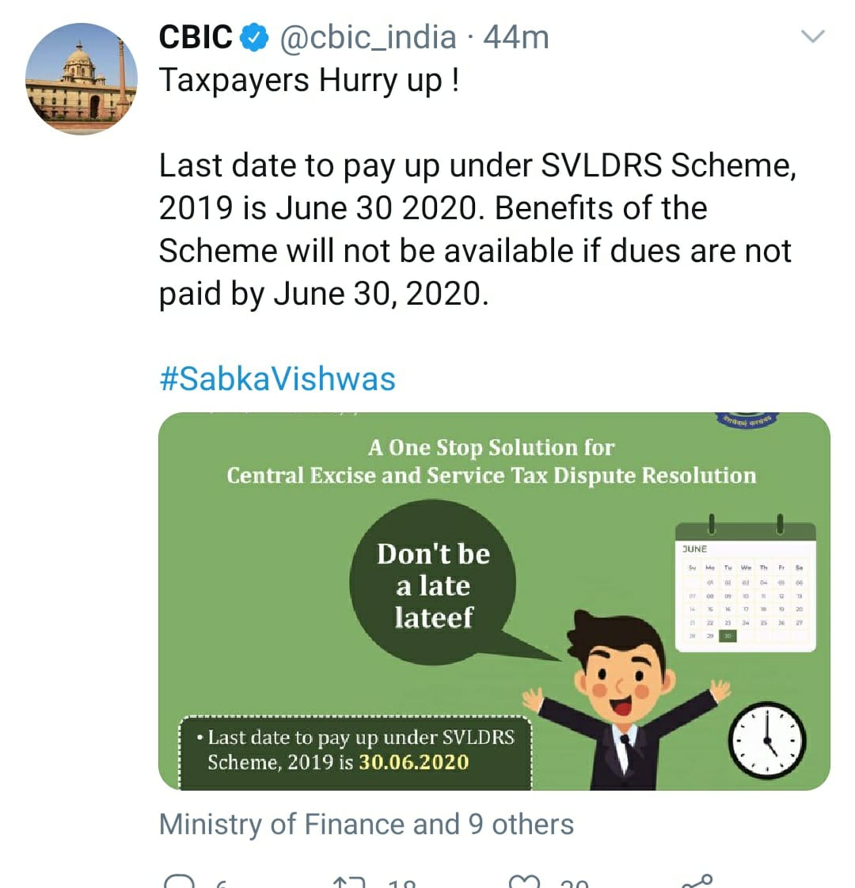
LEGACY LAWS & SABKA VISHWAS…
If the due date for filing appeal/reply, issuance of notice / order etc. falls between 20.03.2020 to 29.06.2020, the time limit is extended up to 30.06.2020 under Central Excise Act, 1944, Customs Act, 1962, Customs Tariff Act, 1975 and Finance Act, 1994.
The due date for making the payment under Sabka Vishwas after the issuance of SVLDRS-3, is extended upto 30.06.2020.

Slide 28
E – WAY BILLS VALIDITY…
E-way bill generated on or before 24th March 2020, period of validity expired on or after 20th March, 2020, the validity period of such e-way has been extended till the 30th June 2020 in terms of Notification No.47/2020 Central Tax dated 09.06.2020.

Slide 29
REFUNDS
Where the due date for filing refund, falls between “20.03.2020 to 29.06.2020“, the due date has been extended till 30.06.2020. -Notification No. 35/2020-CT dated 03.04.2020.
In case of refund of tax on account of exports, the refund is given by considering the ITC reflecting in GSTR 2A. While the due date for filing GSTR 1 for the period from February 2020 to May 2020, have been deferred, this condition of matching of GSTR-2A for claiming export refund should also be deferred for the refund applied for the period of February 2020 to May 2020. Further, the Rule 36(4) month on month adjustment has been relaxed till the return period of August 2020.
An endorsement needs to be obtained by the SEZ unit/developer where the specified officer endorses that the SEZ has received the supply for authorised operations. Only then the supplier to the SEZ can claim refund. Due to the present situation amid the Covid-19, relaxation in compliance of the said rule is to be required - second proviso to Rule 89(1).

Slide 30
THANKS
www.swamyassociates.com
Chennai . Coimbatore . Madurai . Bengaluru . Hyderabad . Pune . Ahmedabad . NEW delhi

